Slide 1
Lesson 1

Slide 2
Discuss what you know about World War II.
What would you like to know about World War II?
In your book write down three questions you would like to find out the answer to about World War II.

Slide 3
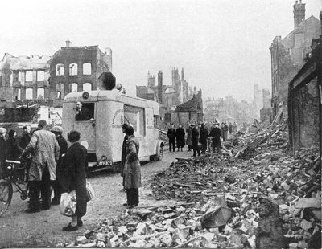
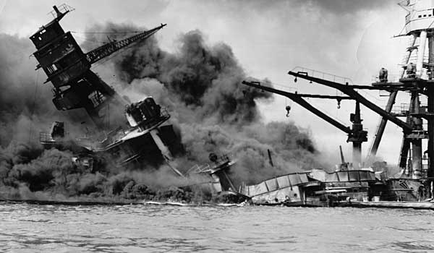
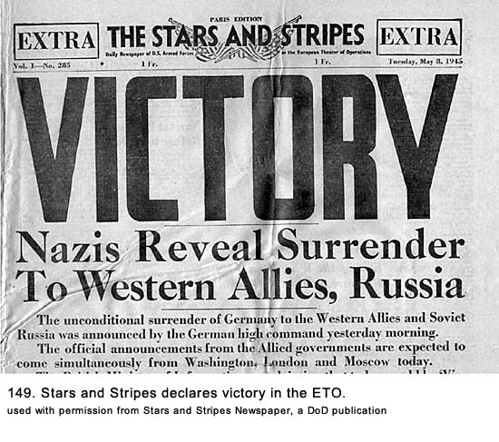
Blitz on London begins.
Japan bombs Pearl Harbor –America joins the war.
Victory in Europe!
Germany begins the invasion of Poland.
First American troops arrive in Europe.

Slide 4
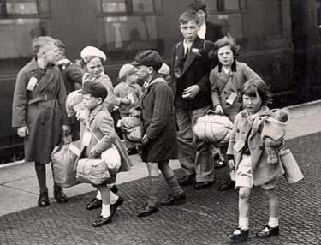
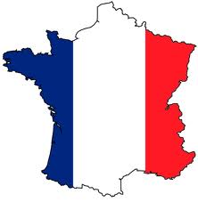
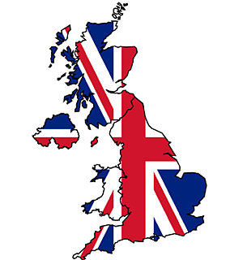
WORLD WAR II TIMELINE
1939
1st September 1939 Germany begins the invasion of Poland.
3rd September 1939 Britain and France declare war on Germany.
Evacuation begins
1940
Blitz on London begins.
Japan bombs Pearl Harbor — America joins the war.
1941

Slide 5
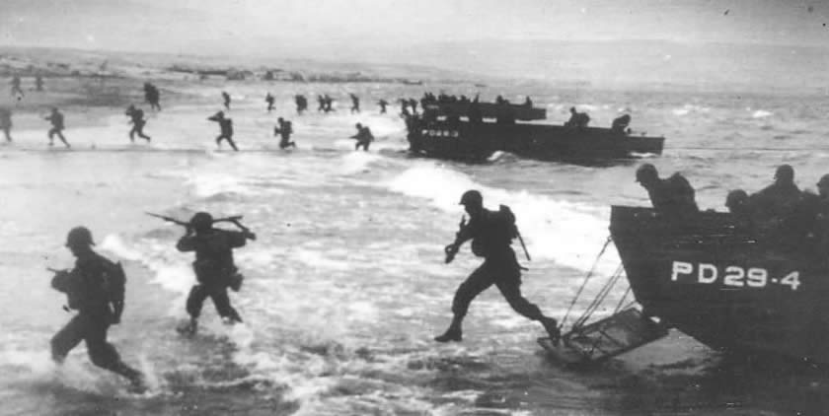
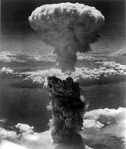
WORLD WAR II TIMELINE
1942
1943
First American troops arrive in Europe.
D Day — Britain, USA and Canada
invade Normandy in France.
1944
1945
Atomic bombs are dropped on two Japanese cities — Japan surrenders.

Slide 6
Blitz on London begins.
Japan bombs Pearl Harbor — America joins the war.
Victory in Europe!
Germany begins the invasion of Poland.
First American troops arrive in Europe.

Slide 7
Evacuation begins.
D Day — Britain, USA and Canada
invade Normandy in France.
Britain and France declare war on Germany.
Atomic bombs are dropped on two Japanese cities — Japan surrenders.

Slide 8
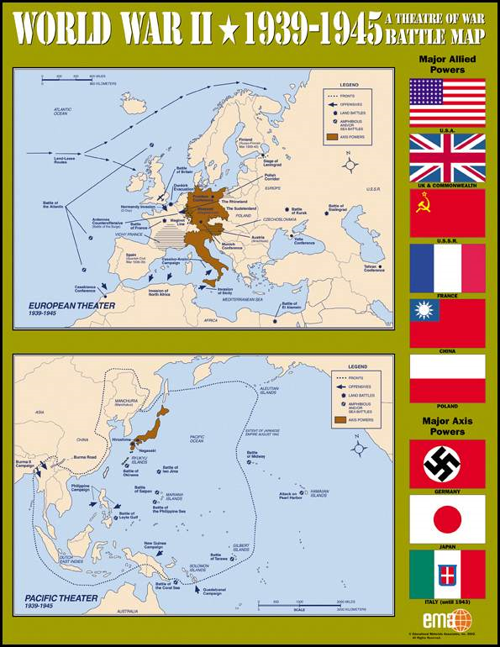
Maps to support challenge 3

Slide 9
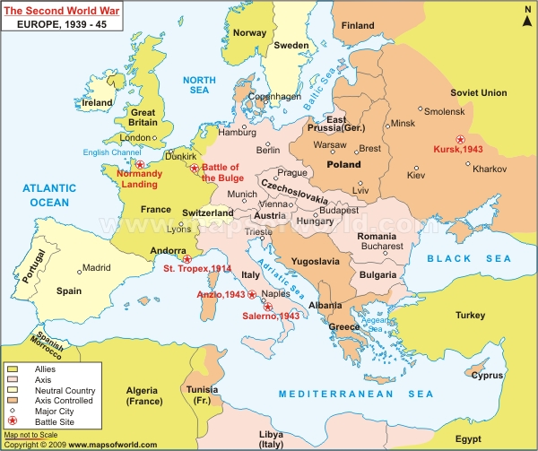

Slide 10
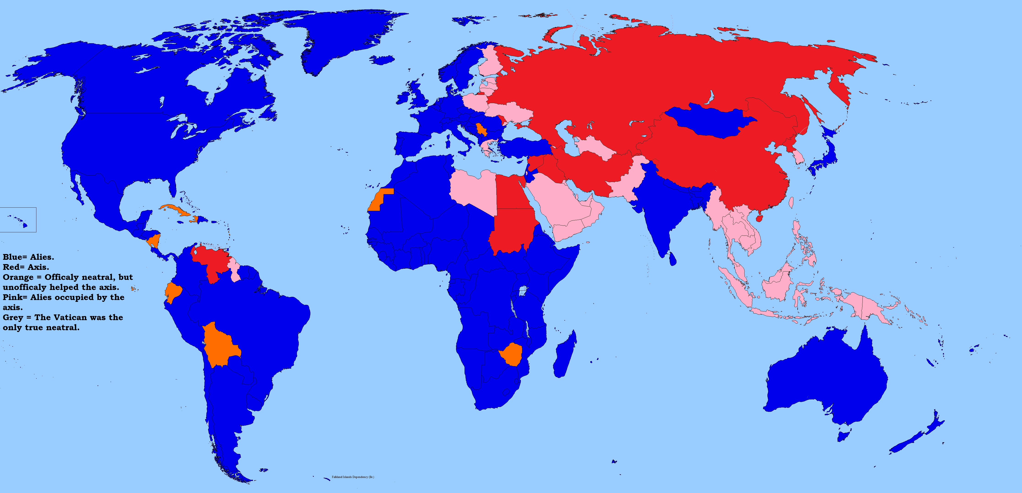

Slide 11
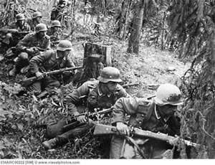
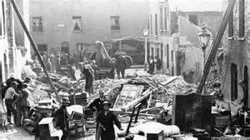
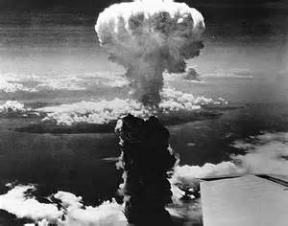
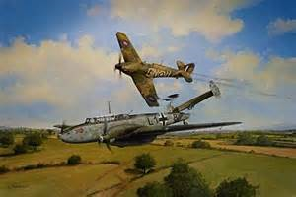
Additional images

