Slide 1
Lesson 2

Slide 2
If you were a German commander in World War II where would you choose to bomb in England? Why?

Slide 3
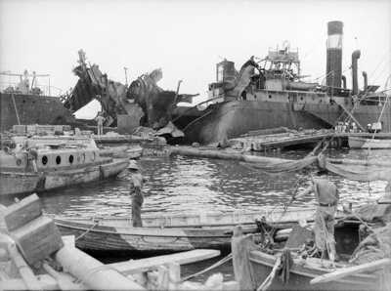
What has been bombed here?
Why would the Germans bomb British ports and ships?

Slide 4
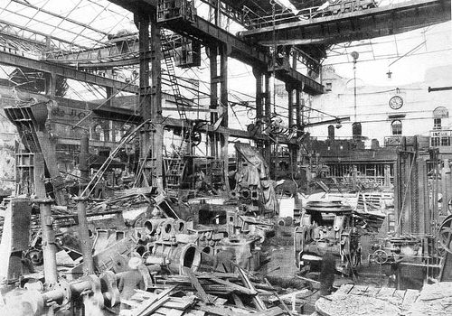
What has been bombed?
Why would the Germans bomb British factories?

Slide 5
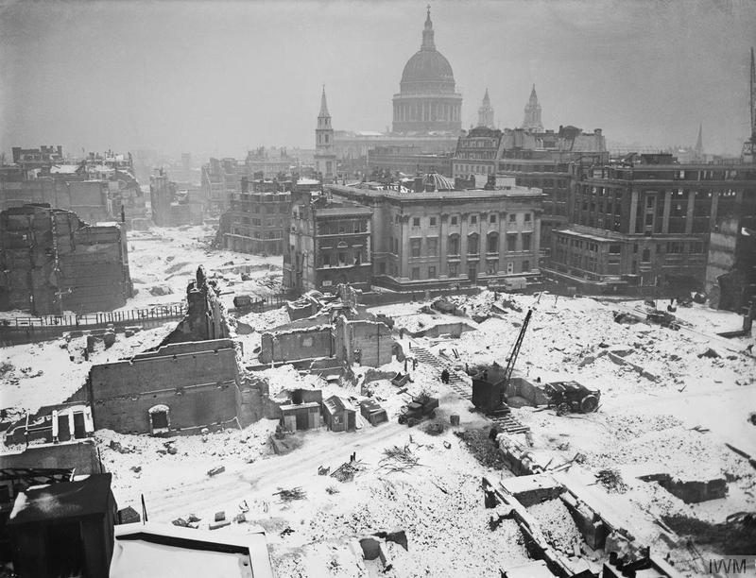
What has been bombed here?
Why would the Germans bomb British cities?

Slide 6
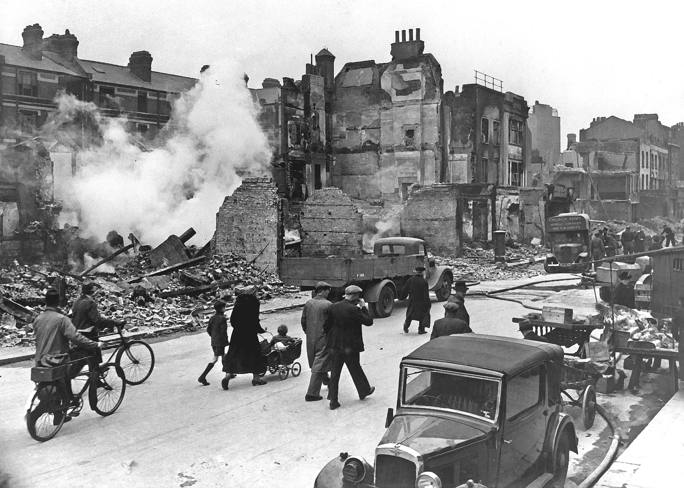
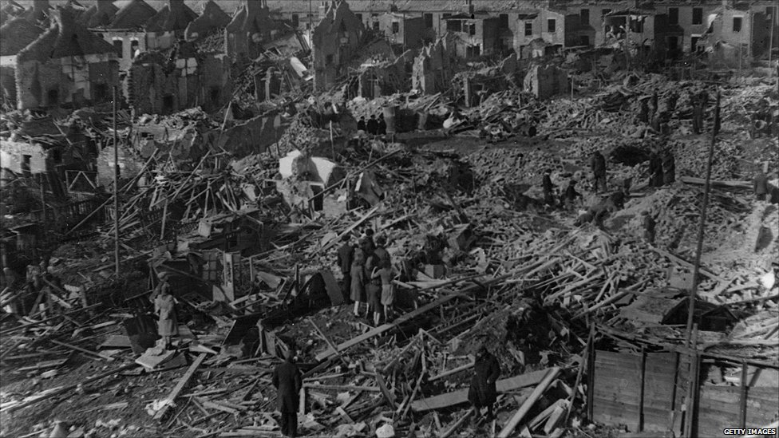
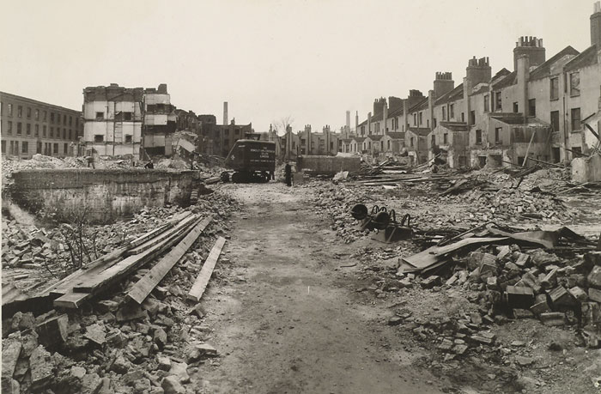

Slide 7
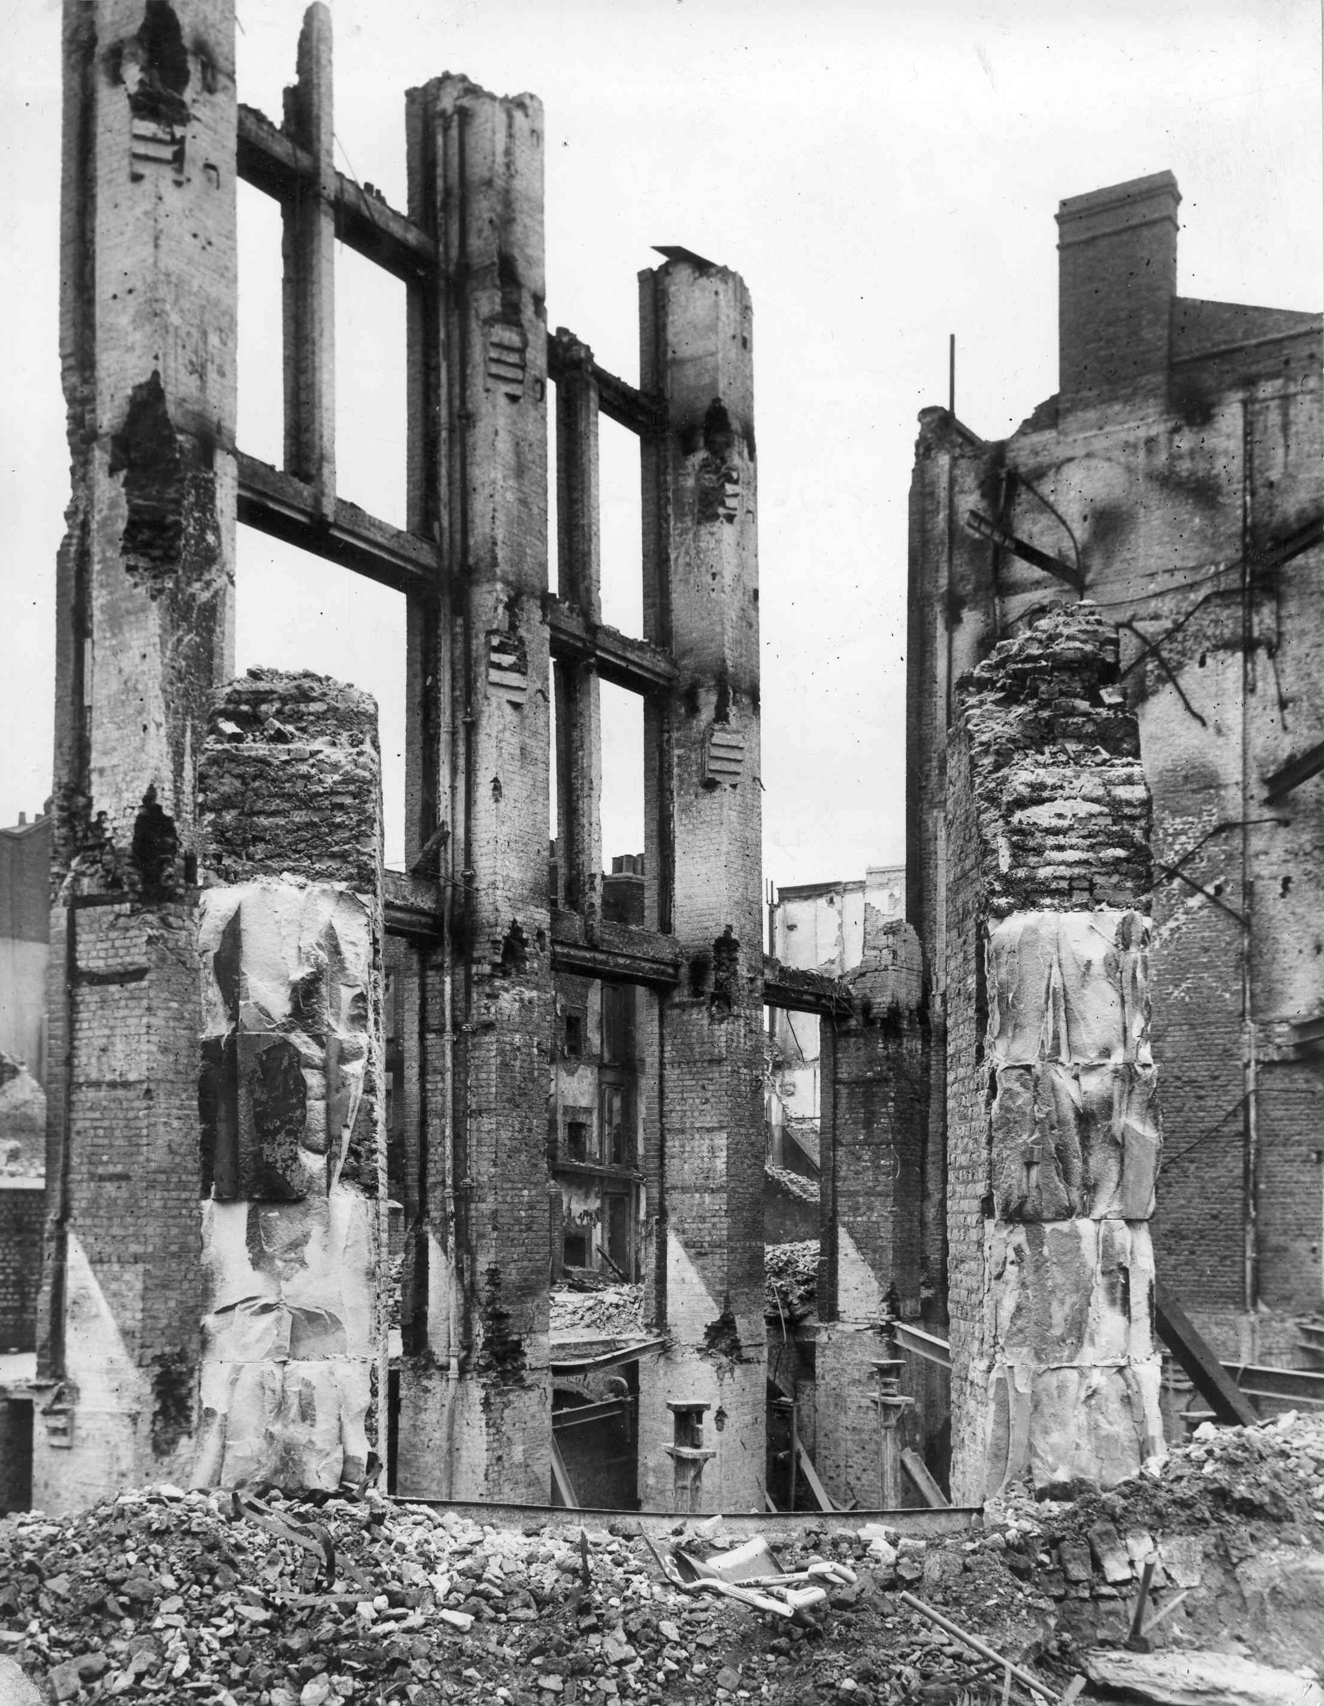
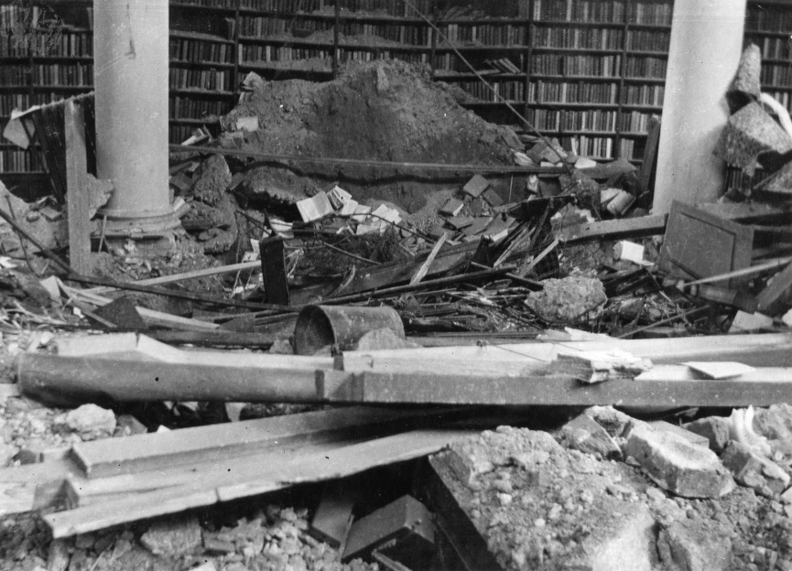
Bethnal Green Road 1941.
Bethnal Green Library bomb damage.

Slide 8
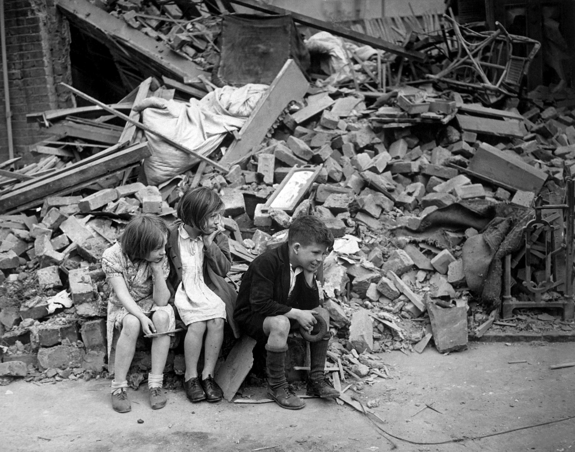
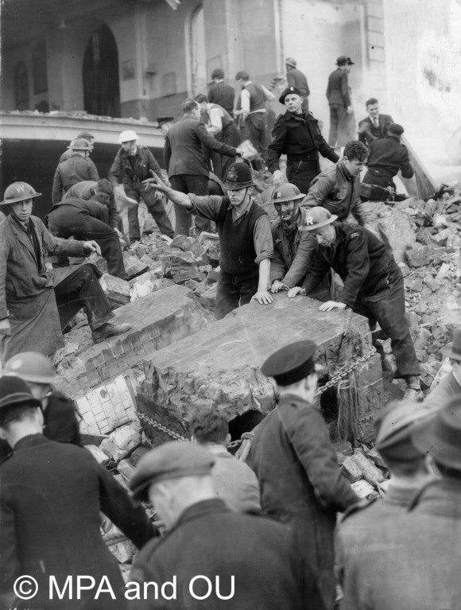
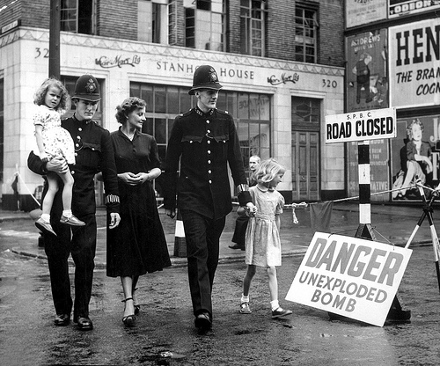
What effect do you think the bombing had on people living in the bombed areas?

Slide 9
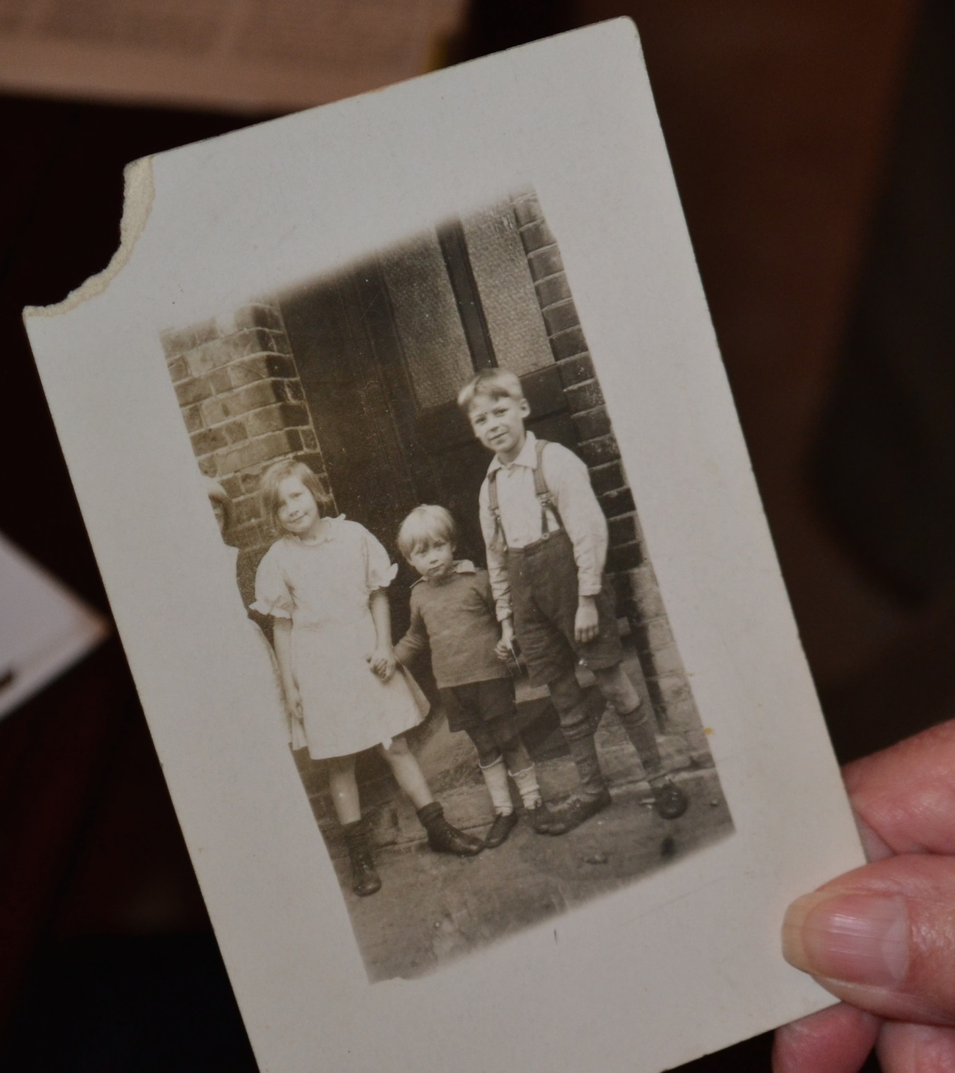
Audio clip 1
Peter Perryment (centre) and his siblings.

Slide 10
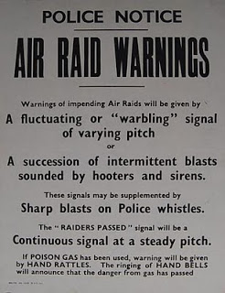
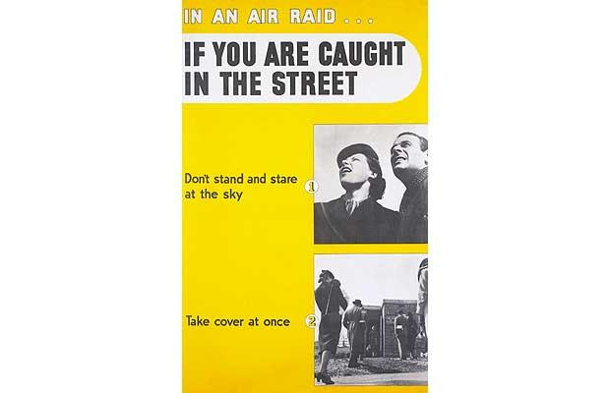
How to act when you hear an air-raid signal
When you hear the warning take cover at once. Remember that most of the injuries in an air raid are caused not by direct hits by bombs but by flying fragments of debris or by bits of shells. Stay under cover until you hear the sirens sounding continuously for two minutes on the same note, which is the signal "Raiders Passed". Air-Raid Warnings 1939

Slide 11
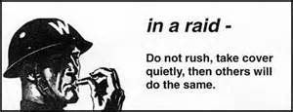
So how would you react to an air-raid warning during the Blitz in 1942?
Let’s see if you can do it now!! When you here the air-raid warning move to a place of safety.
Short (45s)
Long 4m 30s

Slide 12
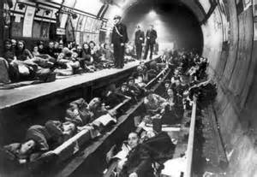
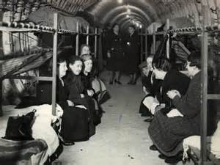
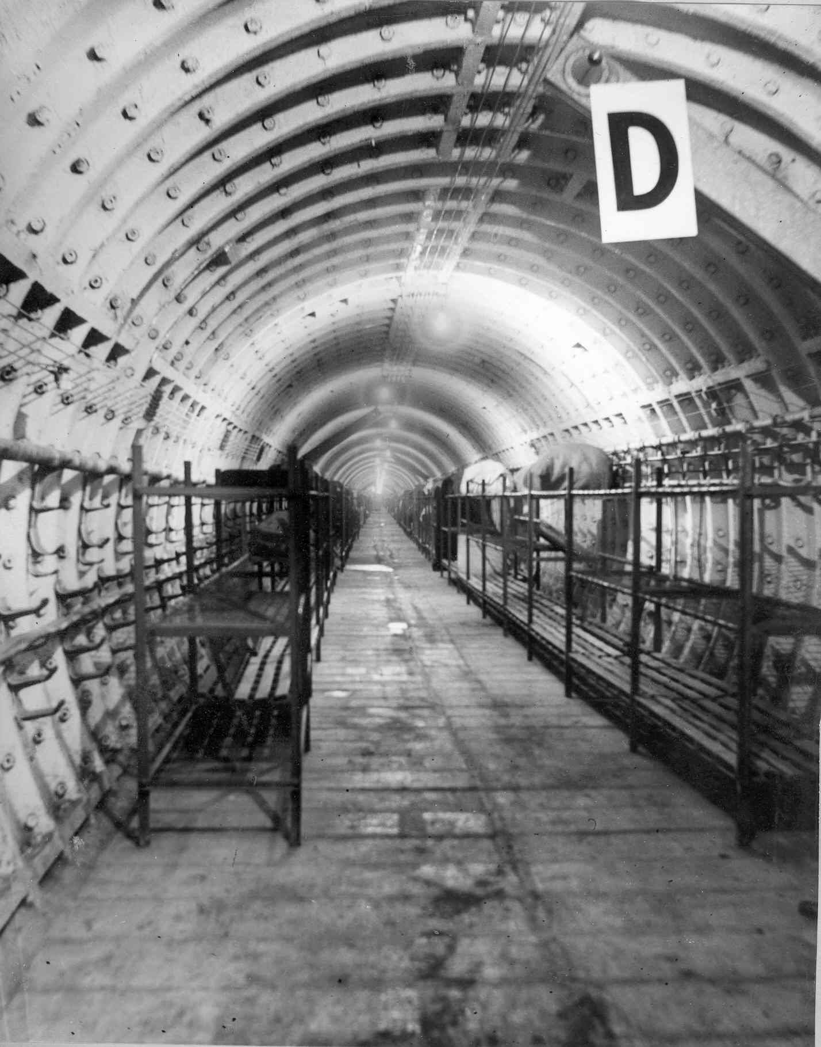
What do you notice about these bomb shelters?
The top-right and bottom-left photos are of Bethnal Green Station which was used as a shelter. It was newly built, had no trains or rails yet, and had lots of space in it. There were bunk beds and even a hall for performances.

Slide 13
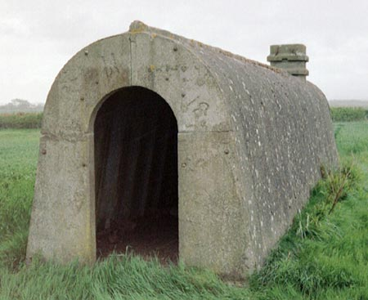
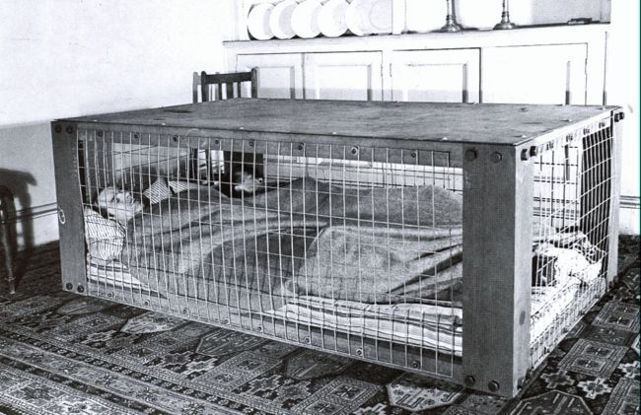
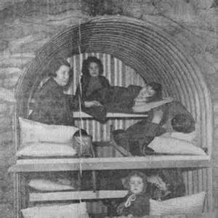
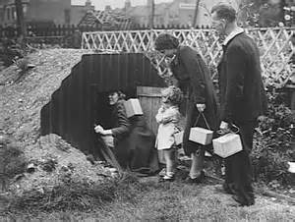
World War II Shelters
Prefabricated air-raid shelter.
Morrison shelter.
Anderson shelters.

Slide 14
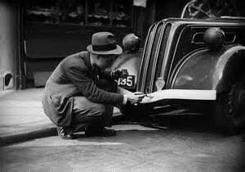
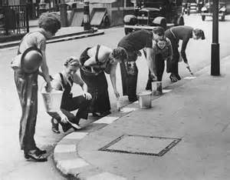
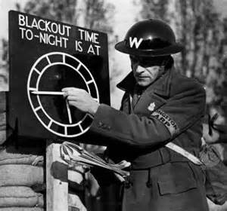
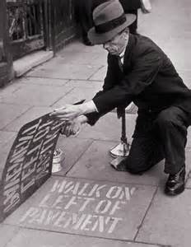
How people coped in the Blackout
Painted bumpers white instead of using lights.
Painted curb stones white so people could see where they were going.

Slide 15
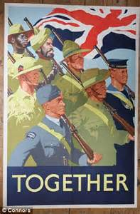
Morale-boosting campaigns during WWII

