Slide 1
Lesson 7

Slide 2
How is the disaster being remembered?
Until now the event has been very simply memorialised on a small plaque in the Bethnal Green underground station but, following a campaign by survivors and relatives, money has been raised for the erection of the first phase of a substantial site of remembrance next to the station.
The memorial design is architecturally and artistically striking and will be a prominent feature on the Bethnal Green landscape for years to come.

Slide 3
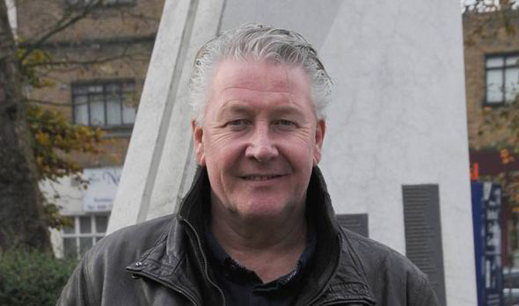
Audio clip 7
Tommy Walsh – patron of the Stairway to Heaven charity

Slide 4
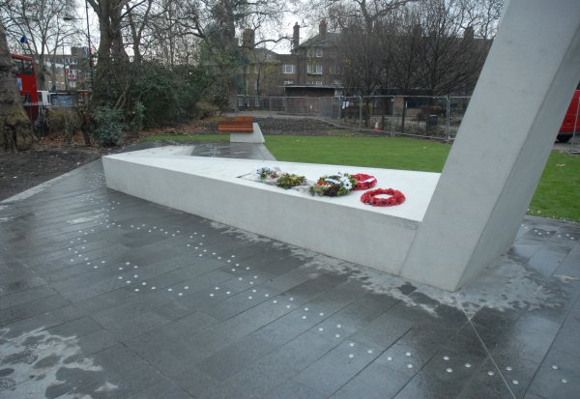
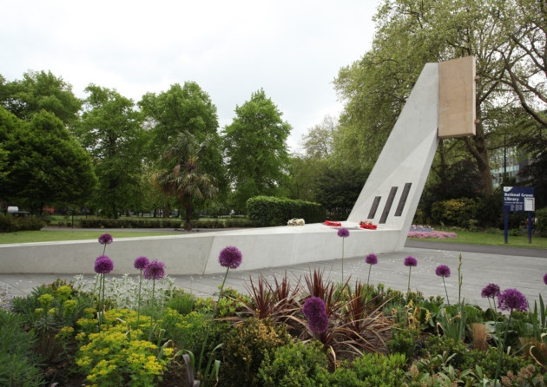
Bethnal Green Memorial as it currently looks.

Slide 5
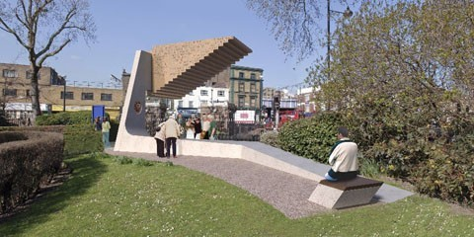
Artist’s impression of the proposed memorial. The Stairway to Heaven Memorial Charity are currently trying to raise an extra £50,000 to finish the staircase.

Slide 6
– What do you think about the design?
– Why do you think this design was chosen?
– Using what you know of the disaster, what sort of a design would you have made?

Slide 7
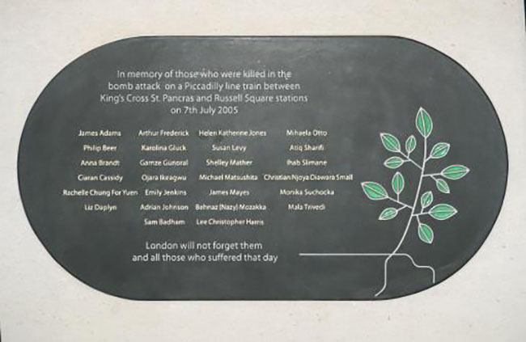
Memorial for victims of a bomb attack on the Underground.

Slide 8
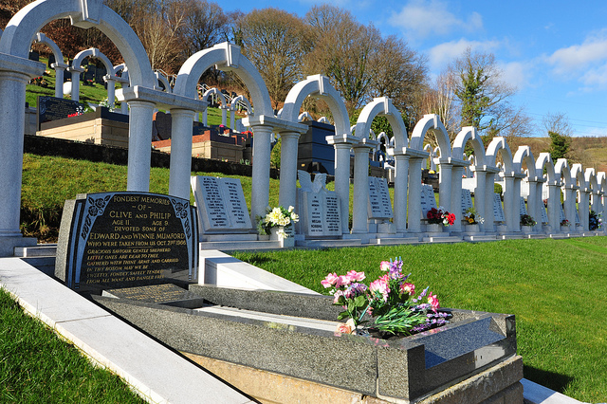
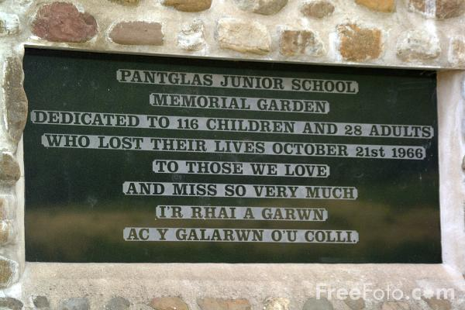
Memorial to the 116 children and 28 adults who died in the Aberfan disaster.

Slide 9
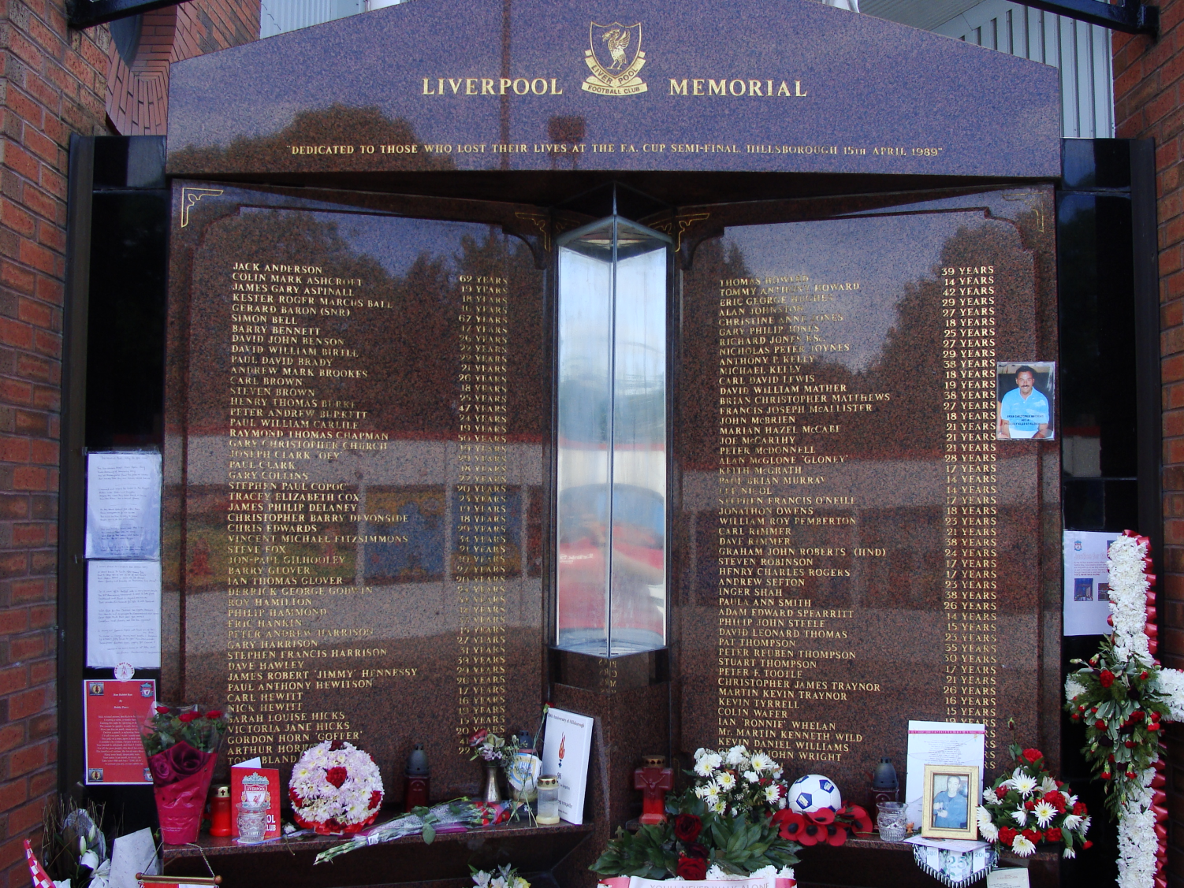
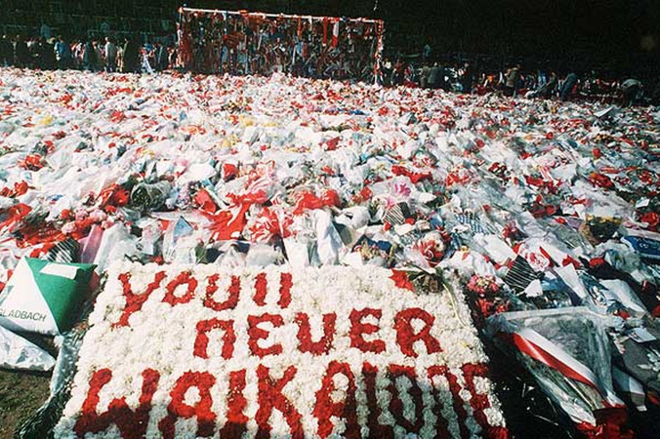
Memorial to the 96 people who died in the Hillsborough disaster.

Slide 10
Final Challenge
Design your own memorial for the Bethnal Green tube disaster. It can be a written dedication to be displayed, a 3-D memorial, a picture with words… just keep in mind what happened to make the memorial relevant and appropriate.

Slide 11
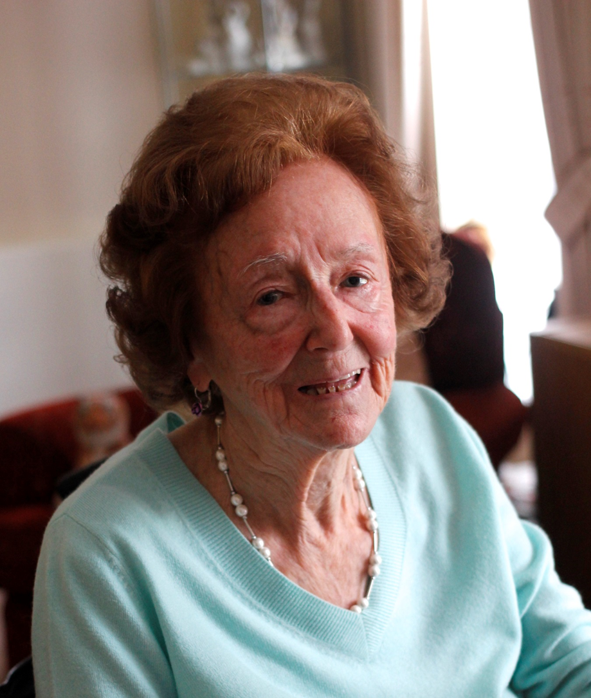
Audio clip 8
The final words go to….
Charlotte Ellen Spicer

